Slide 1
MATHEMATICAL QUIZ
Pawan Kumar Ray
M.Sc(Maths), M.A ( EDU.) M.Ed, NET & SLET
Assistant Professor
Harkamaya College of Education Gangtok, Sikkim
COUNSELOR: CBSE, IGNOU, SBI ,NABARD etc.
Director: Competition coaching centre, Siliguri & Gangtok
President: Dr. Hedgewar Library Madhubani, Bihar .
Email:ccc4job@gmail.com
Contact No. 7908401075/ 9832359082
Blog:pawan4job.blogspot.com

Slide 2
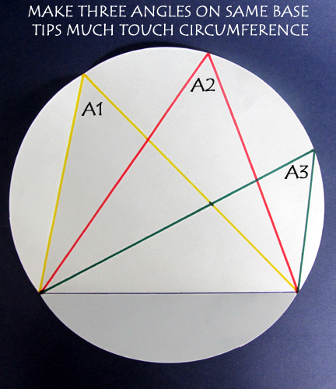

Slide 3
QUESTION NO.1
If angle A2 is 57⁰,what is the measure the Sum of angle A1 & A3?

Slide 4
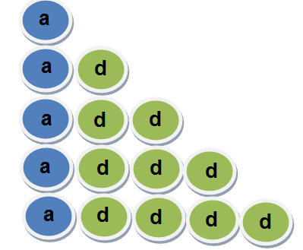
QUESTION NO. 2
Let a be the first term, d be the common difference of a given sequence.
What do you think would be the 100th term? ____________________

Slide 5
QUESTION NO. 3
For which of the following sequences the common difference will be same. Justify your answer a_{n} = 1+ 2n a_{n} = 1+ 2n³ a_{n} = 1+ 2n² a_{n} = n²+ 2n

Slide 6
QUESTION NO. 4
How to arrange any digits, excluding 0, 8 times, by using any mathematical operations with bracket, so that the result is 1,000?

Slide 7
QUESTION NO. 5
How to write or arrange digit ‘9’, by using any mathematical operations with bracket, so that the result is 1,00,000?

Slide 8
QUESTION NO. 6
How to arrange number ‘3’ 6 times, by using any mathematical operations, so that the result is 31?

Slide 9
QUESTION NO. 7
By using numbers 4, 4,4,4,8, how can you make number 100, by using any mathematical operations with bracket?

Slide 10
QUESTION NO. 8
How is it possible that: VII+VII=VIII: By replacing one of the line to a different position?

Slide 11
QUESTION NO. 9
You have 9 matchsticks of the same length and size. How to make it 10 without breaking or splitting the matchsticks?

Slide 12
QUESTION NO. 10
Some boys were playing. Two boys were in front of one boy; One boy behind another boy; One boy in the middle. How many boys participated in the game?

Slide 13
QUESTION NO. 11
When we write from 1 to 100 how
many times do we write the digit 9?

Slide 14
QUESTION NO. 12
What is the sum of the first 100
natural numbers?

Slide 15
QUESTION NO. 13
Sum of all the odd numbers between
0 to 50 is?

Slide 16
QUESTION NO.14
Angle described by hour hand in 24 hours is?

Slide 17
QUESTION NO.15
What is the major of :cosec 90⁰/cos 90⁰?

Slide 18
QUESTION NO.16
At the point of contact the angle between radius and tangent to a circle is?

Slide 19
QUESTION NO.17
Radii of 2 cones of same height are in the ratio of 5:7. Find the ratio of their volume?

Slide 20
QUESTION NO.18
What is the ratio of the volume of the hemisphere to that of sphere of same radius?

Slide 21
QUESTION NO.19
A dice is thrown thrice. How many elements are possible in sample space?

Slide 22
QUESTION NO.20
What shape will you obtain ,if you rotate circle along a diameter?

Slide 23
QUESTION NO.21
Find the single discount which is equivalent to two successive discounts of 30% and 20%.

Slide 24
QUESTION NO.22
What will be the difference between the C.I. and the S.I. at the rate of 5% p.a. on an amount of Rs. 4000 at the end of two years?

Slide 25
QUESTION NO.23
If the diameter of a circle is increased by 8% then its % area is increased by ?

Slide 26
QUESTION NO.24
The average of 9 consecutive odd numbers is 53. What is the least odd number ?

Slide 27
QUESTION NO.25
16 men can complete a work in 12 days .In how many days will 24 men complete the same work ?

Slide 28
QUESTION NO.26
The ratio of the ages of a father to that of his son is 5:2 . If the product of their ages in years is 1000, then the father’s age after 10 years?

Slide 29
QUESTION NO.27
4 9 19 ? 79 159 319

Slide 30
QUESTION NO.28
If A=2, B=3, CAT=27, then JOB =?

Slide 31
QUESTION NO.29
In how many different ways can the letters of the word ‘APPLE’ be arranged?

Slide 32
Can you make the number 100 using the digits from 0 to 9 using them only once by any mathematical operation &bracket can be used
QUESTION NO.30

Slide 33
114⁰
a+99d
A
(8888-888) ÷8, (7777-777) ÷7,etc
99999+ 99 ÷99
3 ×3 ×3+3 ÷3
(4+4+4) ×8 +4
VII+ √I
T EN
3
20
5050
625
720⁰
Infinity
90⁰
125: 343
1:2
216
SPHERE
44%
10
16.64%
45
8
60
39
30
60
0+1+2+3+4+5+6+7+(8×9)

Slide 34
Thank you

